Slide 1
The Marriage of Innovation and Athleticism

Slide 2


Performance
Injury Prevention
The use of wearable technology such as GPS help improving performance.
Data analysis sports uses statistics to recognize patterns in athletic performance.
Technology is important when preventing injuries because they monitor athletes' condition in real-time
High-speed cameras and motion capture systems have enabled biomechanical analysis. It reduces injury risks and enhance overall performance.

Slide 3

Fan Engagement
Ethics
Athlete health and privacy are concerns, as wearable devices collect physiological data, necessitating informed consent
Disparities in technology create inequalities in sports, where financial resources, challenges the concept of fair competition
Fans can enjoy games from the best seats in the house, participate in interactive simulations, and explore in-game statistics.

Slide 4
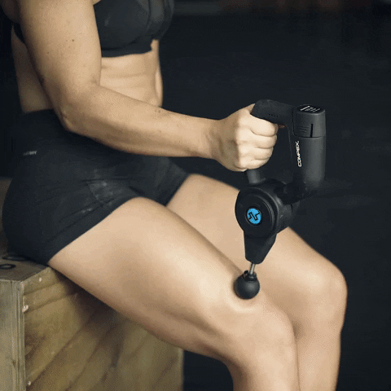

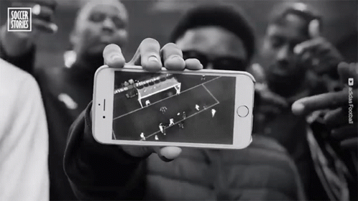
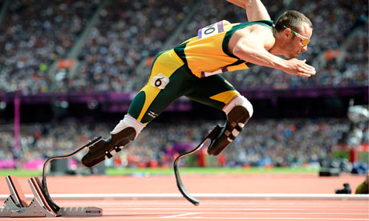
EXAMPLES

Slide 5
Resources:
https://www.workinsports.com/resourcecenter/jobseeker/pages/six-technological-advancements-that-have-changed-sports
https://www.mdpi.com/books/book/7064
https://www.datacamp.com/blog/sports-analytics-how-different-sports-use-data-analysis
https://www.alliancetech.com/the-latest-sports-technology-available-to-prevent-sports-injuries/
https://www.independent.co.uk/sport/ai-sport-tech-artificial-intelligence-var-football-tennis-technology-fans-a8959186.html
https://slideplayer.com/slide/16216393/
ChatGPT Response. (2023). OpenAI.
https://www.harnham.com/sports-analytics-and-the-role-data-plays-in-sport/

